Slide 1
Risk and Return

Slide 2
Topic 5
I. Measuring Risk and Return

Slide 3
A. Return
1. Return can be seen as the reward
for investing.
2. Components of Return
3. Importance of Return
4. Calculating Return
a. Historical Performance
b. Expected Return

Slide 4
A. Return (continued)
Given the following information, calculate the expected return:
Return Probability
-30% .03
-20% .06
-10% .08
0% .15
Return Probability
10% .18
20% .20
30% .13
40% .12
50% .05

Slide 5
A. Return (continued)
n
EV = Σ R_{i}P_{i}
i=1
EV = (-30)(.03) + (-20)(.06) + (-10)(.08) + (0)(.15) + (10)(.18) + (20)(.20) + (30)(.13) + (40)(.12) + (50)(.05)
EV = 14.1%

Slide 6
A. Return (continued)
5. Measuring Return
a. Net Present Value
Example: Suppose we are considering investing in an asset that yields $1000 in year one, $1100 in year two, $1500 in year three and $3200 in year four.
If your required rate of return is 12%, and the asset costs $5000, determine the net present value.
NPV = $1000/(1.12)¹ + $1100/(1.12)² + $1500/(1.12)³ + $3200/(1.12)⁴ - $5000
NPV = -$128.90

Slide 7
A. Return (continued)
c. Internal Rate of Return
d. Modified Internal Rate of Return
Example: MIRR $5000(1 + MIRR)⁴ = $1000(1.06)³ + $1100(1.06)² + $1500(1.06)¹ + $3200
$5000(1 + MIRR)⁴ = $1191 + $1236 + $1590 + $3200
$5000(1 + MIRR)⁴ = $7217
[(1 + MIRR)⁴]^{1/4} = [1.4434]^{1/4}
1 + MIRR = 1.0961
MIRR = 9.61%

Slide 9
A. Return (continued)
6. Six Functions of a Dollar
Future Value of a Single Sum
Future Value of a Series of Payments
Sinking Fund Factor
Present Value of a Single Sum
Present Value of a Series of Payments
Amortization Factor

Slide 10
1. Future Value of Single Sum
?
$
PV
i
N
COMP
FV

Slide 11
2. Future Value of an Annuity
?
$
$
$
PMT
i
N
COMP
FV

Slide 12
3. Sinking Fund
$
?
?
?
FV
i
N
COMP
PMT

Slide 13
4. Present Value Single Payment
$
?
FV
i
N
COMP
PV

Slide 14
5. Present Value of the Annuity
?
$
$
$
PMT
i
N
COMP
PV

Slide 15
6. Amortized Loans
$
?
?
?
PV
i
N
COMP
PMT

Slide 16
B. Risk
Risk is the chance that the actual return from an investment may differ from its expected value.
“Risk is not knowing what you are doing.” Warren Buffett
Statistically, risk is measured by calculating the total variation from the expected value.
The common measure used is the standard deviation.

Slide 17
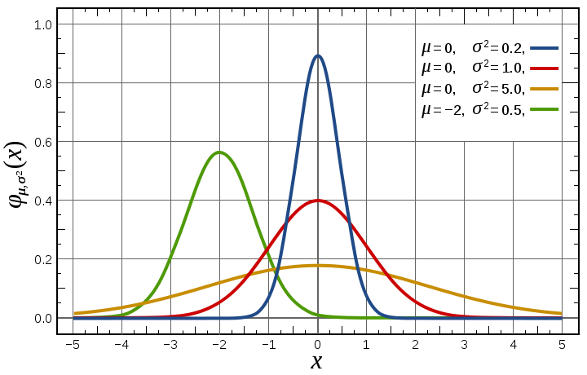
B. Risk (continued)
Returns Std. Deviation
Stock A
Stock B
Stock C
Market
Notes:
Notice that stock A,B, and C all have the same expected return of “0”, but the expected return on the Market is -2%. However notice that the calculated standard deviations for stocks A,B, and C vary widely suggesting different degrees of risk. So in this case the best investment would be Stock A with the smallest standard deviation of .2%.

Slide 18
B. Risk (continued)
1. Calculating Risk
n
σ² = Σ ((R_{i} - EV)²)P_{i}
i=1
σ = (-30 - 14.1) (.03) + (-20 - 14) (.06) + (10 - 14.1)²(.08) + (0 - 14.1)²(.15) + (10 -14.1)²(.18) + (20 - 14.1)²(.20) + (30 - 14.1 )²(.13) + (40 - 14.1)²(.12) + (50 - 14.1)²(.05)

Slide 19
B. Risk (continued)
2. Sources of Risk
a. Business Risk
b. Financial Risk
c. Purchasing Power Risk
d. Interest Rate Risk
e. Liquidity Risk
f. Market Risk

Slide 20
B. Risk (continued)
3. Beta Risk
a. Calculating Beta
Suppose we have the following data:
Year Return J Return M
2007 38.6% 23.8%
2008 -24.7% -7.2%
2009 12.3% 6.6%
2010 8.2% 20.5%
2011 40.1% 30.6%
β = 1.6; ρ = .91

Slide 21
B. Risk (continued)
4. Evaluating Risk
Why is a low risk (less volatile) stock better than a high beta stock. The following example demonstrates why. Assume two investors each have $100,000 and each average 15% return over a five year time horizon. Investor A has a low beta stock while investor B has a high beta stock. Assume at the end of three years both have averaged 15% so the value of their portfolio would be $152,000. However in the fourth year assume that investor B’s stock goes down by 15% while investor A’s goes up 15%. At the end of the fourth year investor A’s portfolio would be worth $175,000, while investor B’s would be worth approximately $129,000. Now in order for investor B’s total returns over the 5 year period to average 15%, he would have to have a return of 56% in the last year to get all the way back to the value of investor A’s portfolio which is now worth $201,000. The “steady eddy” stock has a tendency to do better for you in the long run. We will soon see how to identify the “steady eddy’s” in the stock market.

Slide 22
Investment Fundamentals
Topic 5
II. Using Leverage and OPM

Slide 23
A. Margin Trading
1. How it works
Example: Assume you have $2000 to invest. The margin requirement is equal to 50%. The margin loan costs 15% per year. Further assume that you buy the stock at $50/share.
a. If you don’t use margin, you can purchase a total of 40 shares ($2000/$50). Suppose after 1 year the stock has a price of $60/share.
Profit $2400 - $2000 = $400
Return $400/$2000 = 20%

Slide 24
A. Margin Trading (continued)
b. Suppose after 1 year the stock has a price of $40/share.
Loss = $1600 - $2000 = -$400
Return = -$400/$2000 = -20%
*Notice that the dollar return (loss) and percentage return (loss) are the same.

Slide 25
A. Margin Trading (continued)
c. Suppose now you use margin and can borrow an additional $2000 with a one year interest charge of $300. You can now buy 80 shares ($4000/$50). Again assume that the price of the stock increases to $60 per share.
Profit = $4800 - $2300(brokers) - $2000 = $500
Return = $500/$2000 = 25%

Slide 26
A. Margin Trading (continued)
d. Suppose after 1 year the stock has a sales price of $40/share.
Profit = $3200 - $2300 - $2000 = -$1100
Return = -$1100/2000 = -55%
*Notice the return and loss are magnified by margin use. Also notice that the downside loss potential is greater than the upside gain potential.

Slide 27
A. Margin Trading (continued)
Conclusion: The lower the margin %, the greater the risk.
Exercise: Try this example with a margin of 10% as it was in 1929.
In today’s market, the margin is around 50 to 60% for stocks, but can be less than 10% for some commodities and financial futures.

Slide 28
B. Selling Short
1. Essentials
2. Making money when prices fall
Example: You believe the price of a stock will decrease and you borrow 100 shares from your broker. You sell the shares at $40/share today. One month from now the price falls to $35/share and you buy 100 shares back to return to your broker.
Profit: $4000 - $3500 = $500
Return: $500/0 = infinite

Slide 29
Warren Buffett’s Thoughts on Risk
Charlie Munger (Buffett’s business partner) and Buffett decided long ago that in an investment lifetime it’s just too hard to make hundreds of smart decisions. That judgment became ever more compelling as Berkshire’s capital mushroomed and the universe of investments that could significantly effect our results shrank dramatically. Therefore, we adopted a strategy that required our being smart--not too smart at that--only a very few times. Indeed, we’ll now settle for one good idea a year…..

Slide 30
Buffett on Risk Continued
The strategy they’ve adopted precludes their following standard diversification dogma. Many pundits would therefore say the strategy must be riskier than that employed by more conventional investors. They disagree. They believe that a policy of portfolio concentration may well decrease risk if it raises, as it should, both the intensity with which an investor thinks about a business and the comfort level he must feel with its economic characteristics before buying into it. In stating this opinion, we define risk, using dictionary terms, as “the possibility of loss or injury.”

Slide 31
Buffett on Risk Continued
Academics, however, like to define investment ‘risk’ differently, asserting that it is the relative volatility of a stock or portfolio of stocks--that is, their volatility as compared to that of a large universe of stocks. Employing data bases and statistical skills, these academics compute with precision the ‘beta’ of a stock--its relative volatility in the past--and then build arcane investment and capital-allocation theories around this calculation. In their hunger for a single statistic to measure risk, however, they forget a fundamental principle: It is better to be approximately right than precisely wrong.

Slide 32
Buffett on Risk Continued
For owners of a business--and that’s the way we think of shareholders--the academics’ definition of risk is far off the mark, so much so that it produces absurdities. For example, under beta-based theory, a stock that has dropped very sharply compared to the market…becomes ‘riskier’ at the lower price than it was at the higher price. The true investor welcomes volatility. A wildly fluctuating market means that irrationally low prices will periodically be attached to solid businesses. It is impossible to see how the availability of such prices can be thought of as increasing the hazards for an investor who is totally free to either ignore the market or exploit its folly.

Slide 33
Buffett on Risk Continued
What we do know is that occasional outbreaks of those two super contagious diseases, fear and greed, will forever occur in the investment community. The timing of these epidemics will be unpredictable. And the market aberrations produced by them will be equally unpredictable, both as to duration and degree. Therefore, we never try to anticipate the arrival or departure of either disease. Our goal is more modest: We simply attempt to be fearful when others are greedy and to be greedy only when others are fearful.

Slide 34
Charles Ponzi
Charles Ponzi started in the Boston area in 1919 with a loan of $200 and 16 investors who put in under $1,000. In les than six months he had thousands of investors and about $10,000,000. He said he was paying 50% interest on short-term investments. He told people he was buying international exchange coupons in foreign countries and getting six times their value in U.S. postage stamps. Buy low, sell high: isn't that what investment is all about? He claimed he was paying friends who invested with him $150 for each $100 invested and that he was doing this in forty-five days, even though he was promising them payment in ninety days. Why not buy the coupons yourself and skip the middleman? That would be greedy, wouldn't it? Besides, it would take effort on the investor's part. Ponzi would do all the work and the investor would enjoy an obscene profit for doing nothing. It didn't take long before he had so much money coming in that he had to move it from under his mattress to a traditional banking institution, which came under scrutiny and led to his undoing.

Slide 35
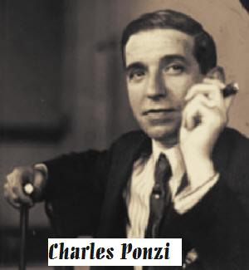
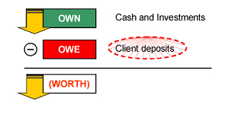
Ponzi Scheme Balance Sheet
Notes:
Cash is depleted to pay for the promised returns to clients. In order to keep going, the Ponzi scheme must attract new client deposits to artificially prop up the investments section of the balance sheet so that the new cash can be used to pay the returns from the investments to earlier investors. In reality, however, the own section of the balance sheet is going down, and therefore the worth is also going down, eventually slipping into negative territory. The result is a constant need for cash, which puts pressure on the firm to attract greater and greater investments at an increasingly rapid rate to pay out those investors seeking redemptions.
It's not difficult to see that Ponzi schemes eventually run into trouble. The cycle stops and the scheme collapses when redemptions exceed assets, which turned out to be Madoff's downfall: the recent economic downturn generated more redemptions than his firm could afford to pay out, which led to his confession to his sons on the evening of December 10. What is remarkable about Madoff's firm is how it stayed in business for decades, while Ponzi's original scheme, for instance, was discovered within a year.

Slide 36
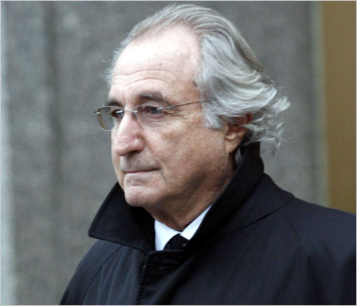
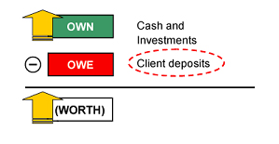
The Madoff Ponzi Scheme
Normal Balance Sheet
Notes:
Madoff's firm offered what most investors seek — low risk and high returns. This should have fallen under the "too good to be true" category, as these concepts are fundamentally at odds. Investors should have seen red flags when they saw that no other investment firms were able to match or even come close to the performance of Madoff's investments. In general, investors accept tradeoffs along a scale of returns, with progressively higher returns generating correspondingly higher risk. In both up and down years, however, investments made by Madoff's firm returned its clients between 12 and 13 percent like clockwork — an unusually steady rate.
Ponzi schemes generate an unsustainable cycle of acquisitions and redemptions. The balance sheet graphics below help illustrate what a Ponzi scheme looks like. Balance sheets depict what a company owns and what it owes. Let's first look at a normal balance sheet, and then one of a Ponzi scheme.
In the case of an investment firm, for example, the "own" part of the balance sheet includes the investments the company makes and any cash it has on hand. The client deposits are the "owe" part of the balance sheet (the company owes its clients the deposits). In a non-fraudulent company, the investments (own) would grow, and the "worth" would grow.

Slide 37
Review Questions: Section 5
Define return in both the expost and exante sense. Describe the various components of return.
If a project cost $6,000 and has a $2,000, $1,200, and $6,000 cash flow over the next three years, calculate the IRR, NPV, Payback, and the MIRR.
Define beta and calculate beta for slide 18 using 2.7% instead of
-24.7% for asset J.
4. What is margin trading? Rework the problem on slide 21 using a margin of only 20%.
5. Suppose you short sell 100 shares of AW stock at $50. Assume the price of the stock falls to $46. What is your net dollar and percentage in profit.
A low beta stock is always better than a high beta stock in the long-run. Is this true? Explain, giving two arguments.
How does Buffett define risk?
Buffett suggests we should be eternally grateful for MPT. Why?

